Slide 1

AI Tools Revolutionizing B2B High-Tech Product Marketing & Management in 2026
Discover the cutting-edge AI solutions transforming how B2B tech companies engage customers, automate workflows, and accelerate growth in an increasingly competitive landscape.

Slide 2

MARKET INSIGHT
Why AI is a Game-Changer for B2B High-Tech Marketing
The B2B marketing landscape is undergoing a fundamental transformation driven by artificial intelligence. Forward-thinking organizations are investing strategically in AI-powered platforms to gain competitive advantages through automation, personalization, and data intelligence.
AI Investment Surge
45% of B2B marketers plan major AI investments by 2026 to drive efficiency and personalization (eMarketer)
AI eliminates time-consuming manual tasks, enables hyper-personalized customer experiences at scale, and empowers teams to make faster, more informed decisions based on real-time insights and predictive analytics.
5× higher ROI achievable through multi-channel AI campaigns versus traditional methods (TofuHQ)

Slide 3
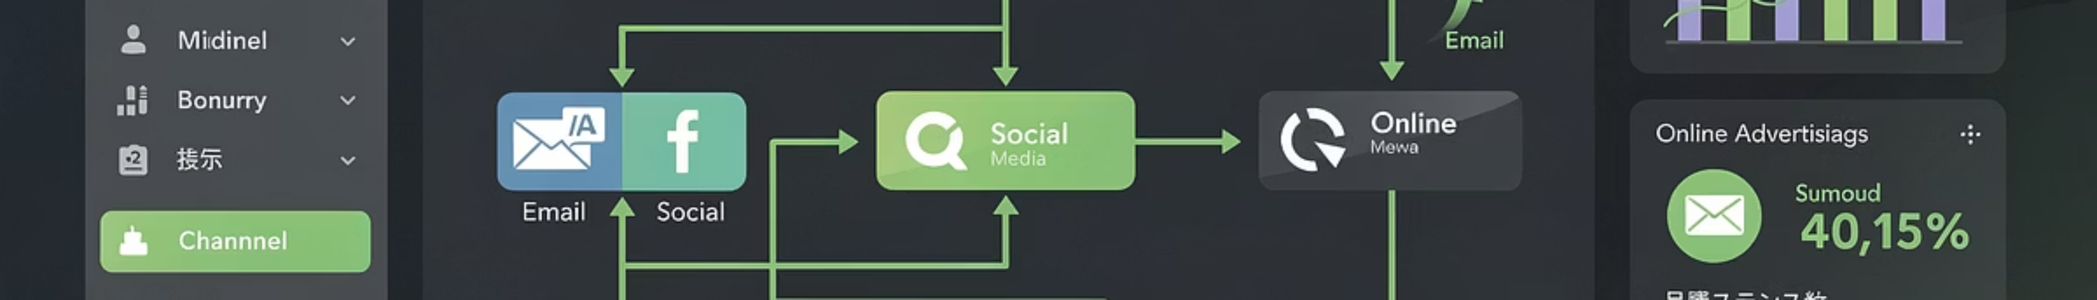




TOOL SPOTLIGHT #1
Tofu – The Ultimate Multi-Channel Campaign Orchestrator
Hyper-Personalized Outreach
Workflow Automation
Enterprise ABM Excellence
Orchestrate coordinated campaigns across email, paid ads, landing pages, and social media with enterprise-grade personalization at scale.
Eliminate repetitive tasks and free your team to focus on strategic initiatives and creative innovation that drive real business impact.
Trusted by leading B2B technology companies for seamless account-based marketing execution and precision targeting.

Slide 4

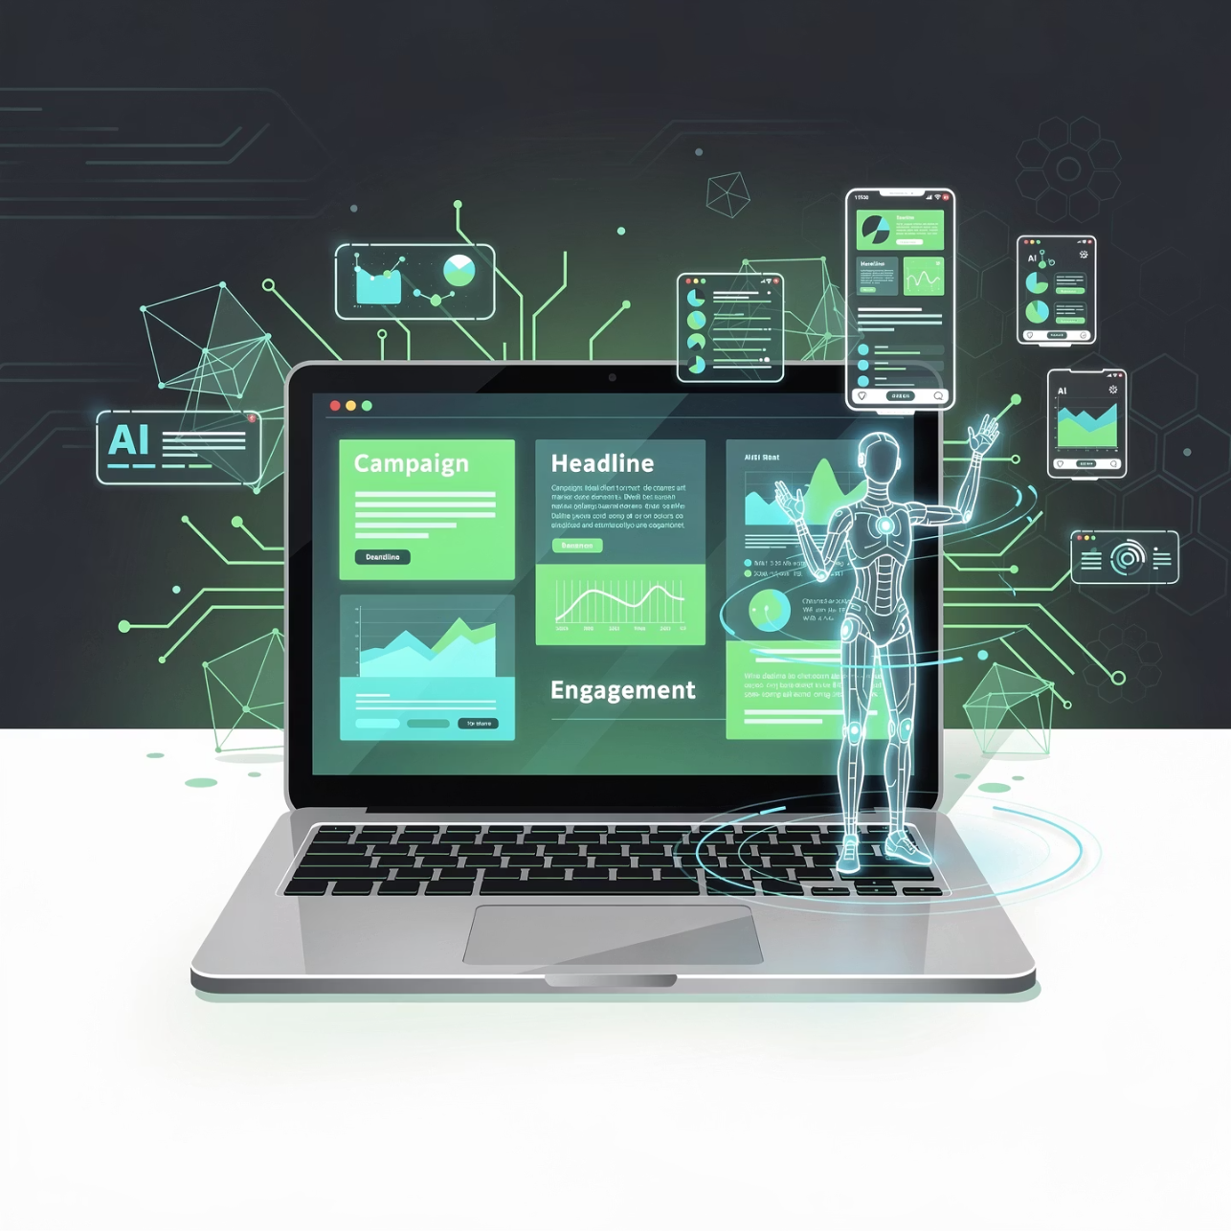


TOOL SPOTLIGHT #2
Jasper & ChatGPT – AI Content Creation Powerhouses
Jasper
Scale production of high-quality, SEO-optimized content specifically tailored for technical B2B audiences. Pricing starts at $39/user/month for professional-grade content generation.
ChatGPT
Versatile AI assistant perfect for drafting personalized emails, crafting product messaging, and enhancing customer engagement. Available from free to $20/month.
Both platforms dramatically accelerate content production cycles, enabling faster go-to-market execution and more effective lead nurturing campaigns.

Slide 5

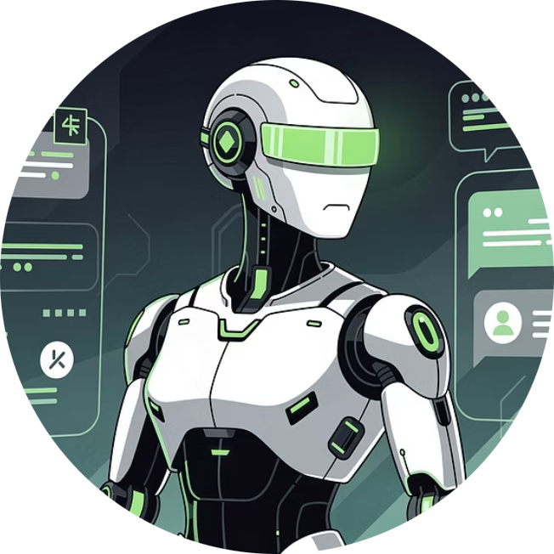

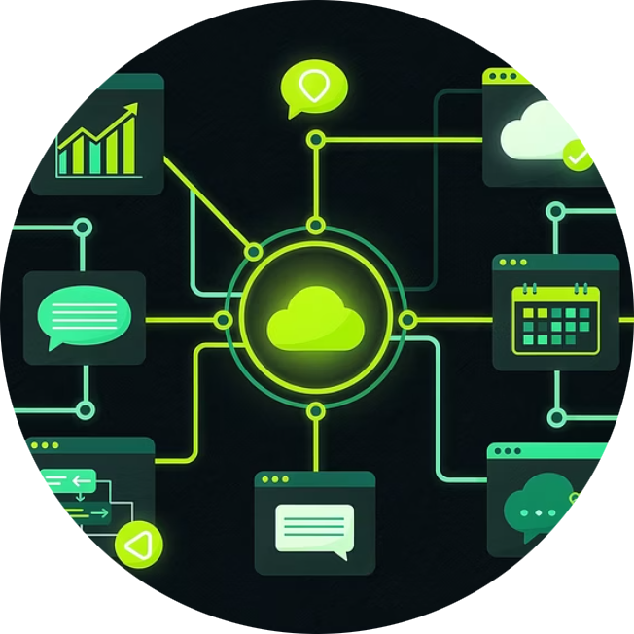
TOOL SPOTLIGHT #3
Eesel AI Suite – AI Agents & Copilots for Support & Marketing
AI Agent
AI Copilot
Seamless Integration
Automates frontline customer support interactions, dramatically improving response times and customer satisfaction scores while reducing support team workload.
Intelligently drafts reply suggestions and assists marketing teams with efficient email composition and support ticket management.
Connects effortlessly with Zendesk, Slack, Shopify, and dozens more platforms, streamlining product marketing and customer success workflows.

Slide 6

Embrace AI to Transform Your B2B Product Marketing in 2026
01
02
Orchestrate at Scale
Personalize & Compete
Combine multi-channel orchestration, AI-driven content creation, and automated support for unmatched operational efficiency.
Leverage AI insights to deliver personalization at enterprise scale and outpace competitors in the high-tech marketplace.
03
Scale Strategically
Start with focused pilots, test intelligently, and scale AI adoption systematically to unlock sustainable growth and continuous innovation.
The future of B2B marketing is here. Organizations that embrace AI-powered tools today will lead their industries tomorrow.

